Slide 1
Python Workshop

Slide 2

Hello!
I am Soumotanu Mazumdar

Slide 3
What is programming?
1
Let’s start with a basic introduction of what programming is.

Slide 4
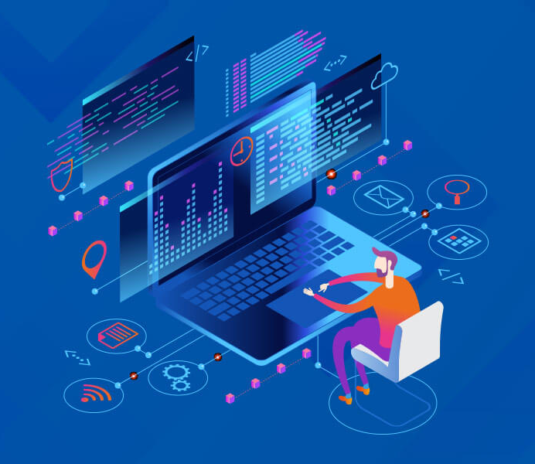
Programming is how you get computers to solve problems.
Programming is a creative task. With the right skills and experience, a programmer can craft software to solve an unlimited number of problems – from telling you when your next train will arrive to playing your favourite music. The possibilities are constrained only by your imagination.

Slide 5
What exactly is a programming language?
2
Programming languages are the tools we use to write instructions for computers to follow.

Slide 6
Low-Level vs. High-Level Programming Languages
Low-Level
Low-level programming languages are closer to machine code, or binary. Therefore, they’re more difficult for humans to read, still easier than 1s and 0s.
High-level
High-level programming languages are closer to how humans communicate. They use words that are closer to the words we use in our everyday lives.

Slide 7
Most popular programming languages
Python
Python is a versatile, general-purpose programming language. It is a great first language to learn.
Java
Java can be used for many things, including mobile applications, software development, and large systems development.
JavaScript
JavaScript is a front-end and back-end language that enables web, game, and mobile applications.
C#
It can be used for a wide variety of applications, including game development, enterprise software, mobile apps, and more.
C++
C++ is one of the most powerful programming languages and is used in a wide range of industries.
PHP
PHP is a widely-used server-side language. It’s a great choice if you’re interested in building dynamic web applications.
R
R is a statistical programming language popular among data scientists. It’s used data analysis and creating data visualizations.
Swift
Swift is Apple’s programming language and is a must if you plan to develop applications for iOS and MacOS.
Kotlin
Kotlin is an open-source programming language developed by JetBrains. It’s popular for Android development.

Slide 8
Python
3
Python is a high-level general-purpose programming language.

Slide 9
Advantages of Python
Beginner friendly
Strong demand
Great support and large community
Doesn’t take long to learn
Versatile
Extensive libraries and frameworks
So yes, if you're looking to get started in programming, Python is a great choice.

Slide 10
Compiler vs. Interpreter
Compiler
A compiler is a program that reads a program written in the high-level language and converts it into machine language and reports the errors in the program. It converts the entire source code in one go or could take multiple passes, but at last, the user gets the compiled code ready to execute.
Interpreter
Interpreters and compilers are very similar in structure. The main difference is that an interpreter directly executes the instructions in the source programming language. An interpreter will typically generate an efficient intermediate representation and immediately evaluate it.

Slide 11
Is Python an interpreted Language?
For the most part, Python is an interpreted language and not a compiled one, although compilation is a step. Python code, written in .py file is first compiled to what is called bytecode (discussed in detail further) which is stored with a .pyc or .pyo format.

Slide 12
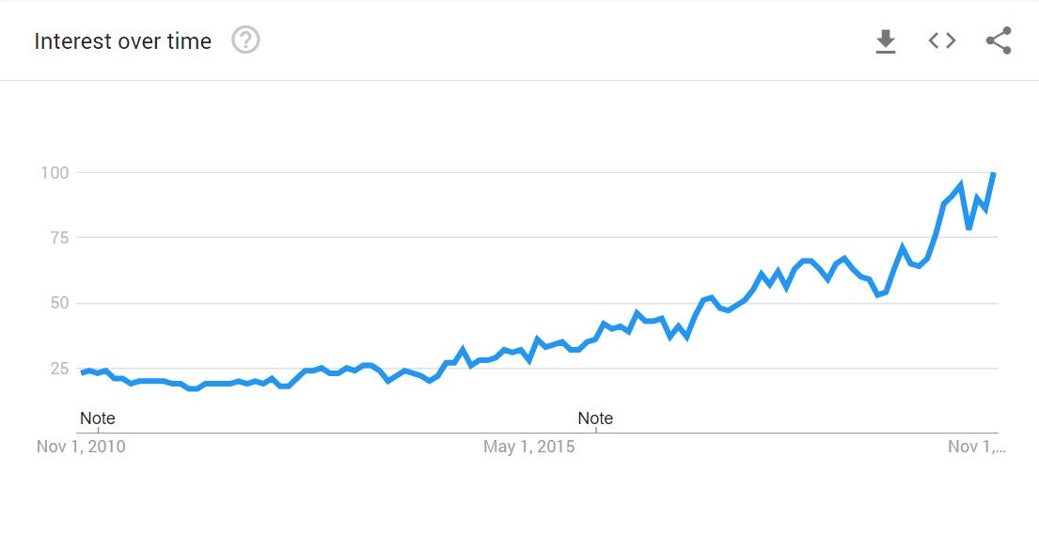
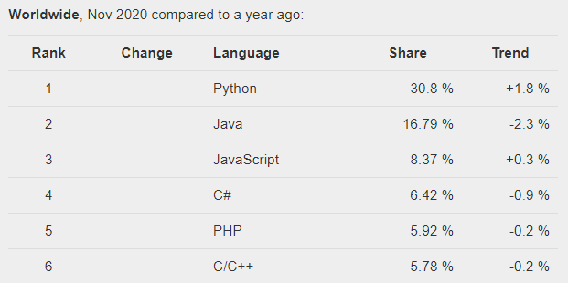
Python Popularity
As you can see, Python has been slowly gaining popularity and now it can be considered to be the most popular programming language in the world.

Slide 13
Python lets you build many types of programs
Business apps to capture, analyze, and process data.
Dynamic web apps that a web browser can access.
Games in both 2D and 3D.
Financial and scientific apps.
Cloud-based apps.
Mobile apps.

Slide 14
Artificial Intelligence
4
Artificial intelligence (AI) refers to the simulation of human intelligence in machines that are programmed to think like humans and mimic their actions.

Slide 15
Artificial Intelligence vs Machine Learning vs Data Science
Artificial Intelligence
Artificial intelligence can be loosely interpreted to mean incorporating human intelligence to machines. Whenever a machine completes tasks based on a set of stipulated rules that solve problems, such a behavior is what is called artificial intelligence.
Machine Learning
As the name suggests, machine learning can be loosely interpreted to mean empowering computer systems with the ability to “learn”. ML is a subset of artificial intelligence; in fact, it’s simply a technique for realizing AI.
Data Science
It is distinguished from the other two fields because its goal is an especially human one: to gain insight and understanding. The main distinction is that in data science there’s always a human involved in Data Science.

Slide 16
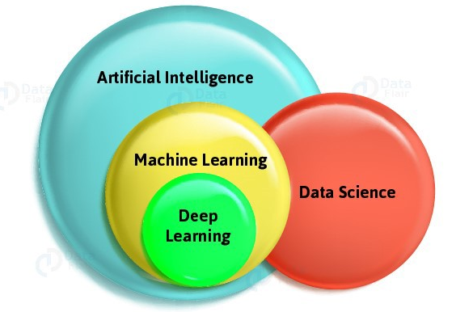

Slide 17
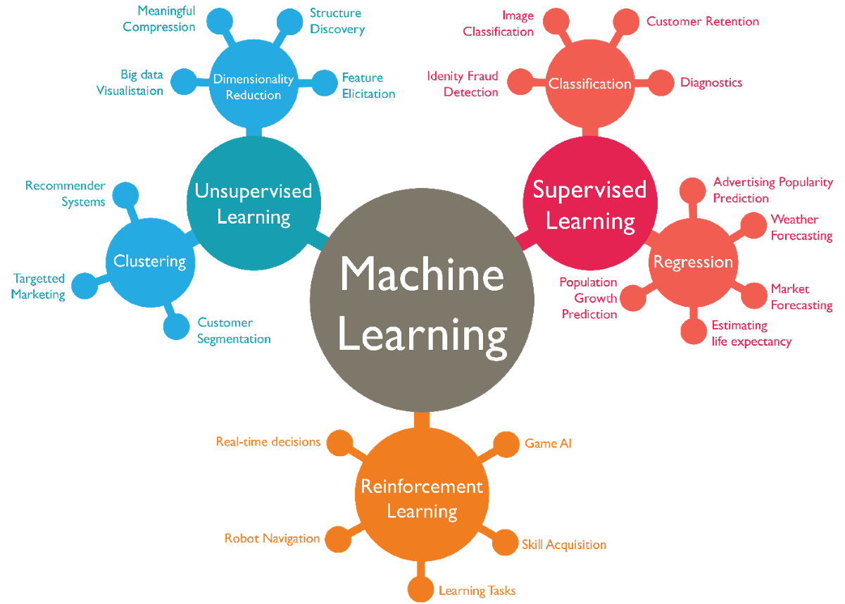
Types of Machine Learning

Slide 18
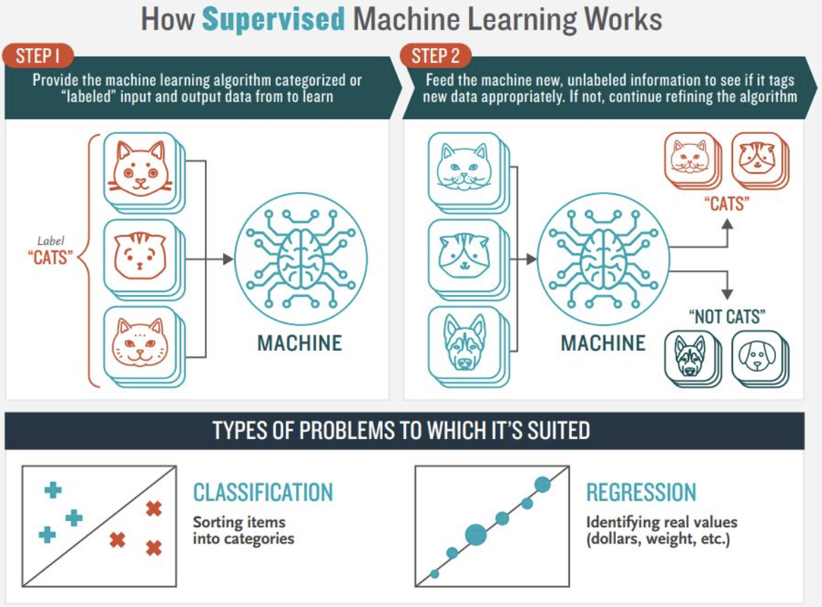
Supervised Learning

Slide 19
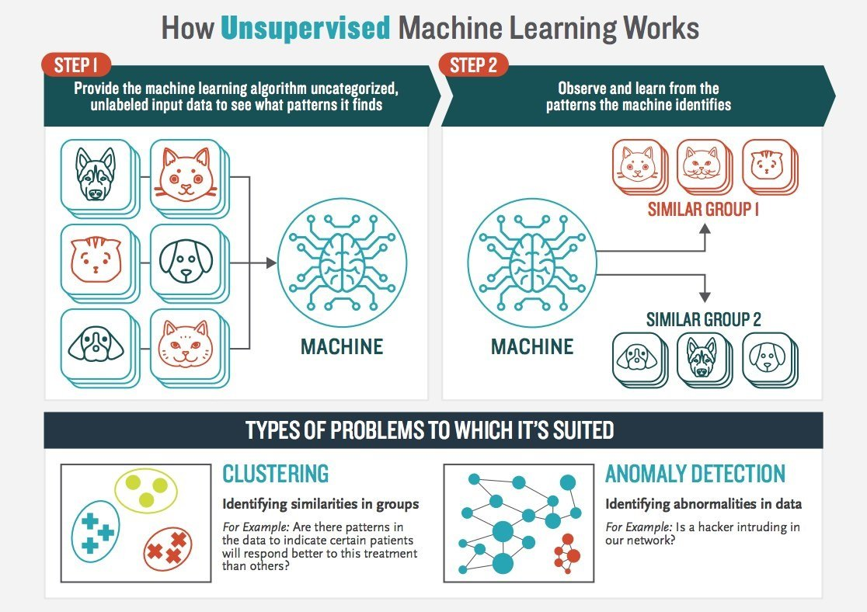
Unsupervised Learning

Slide 20
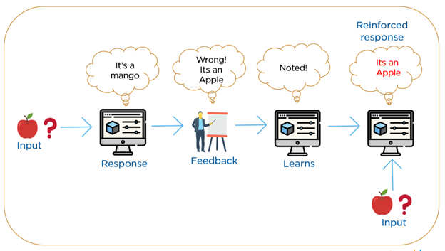
Reinforcement Learning

Slide 21
Neural Network
5
Artificial neural networks, usually simply called neural networks, are computing systems vaguely inspired by the biological neural networks that constitute animal brains. An ANN is based on a collection of connected units or nodes called artificial neurons, which loosely model the neurons in a biological brain.

Slide 22
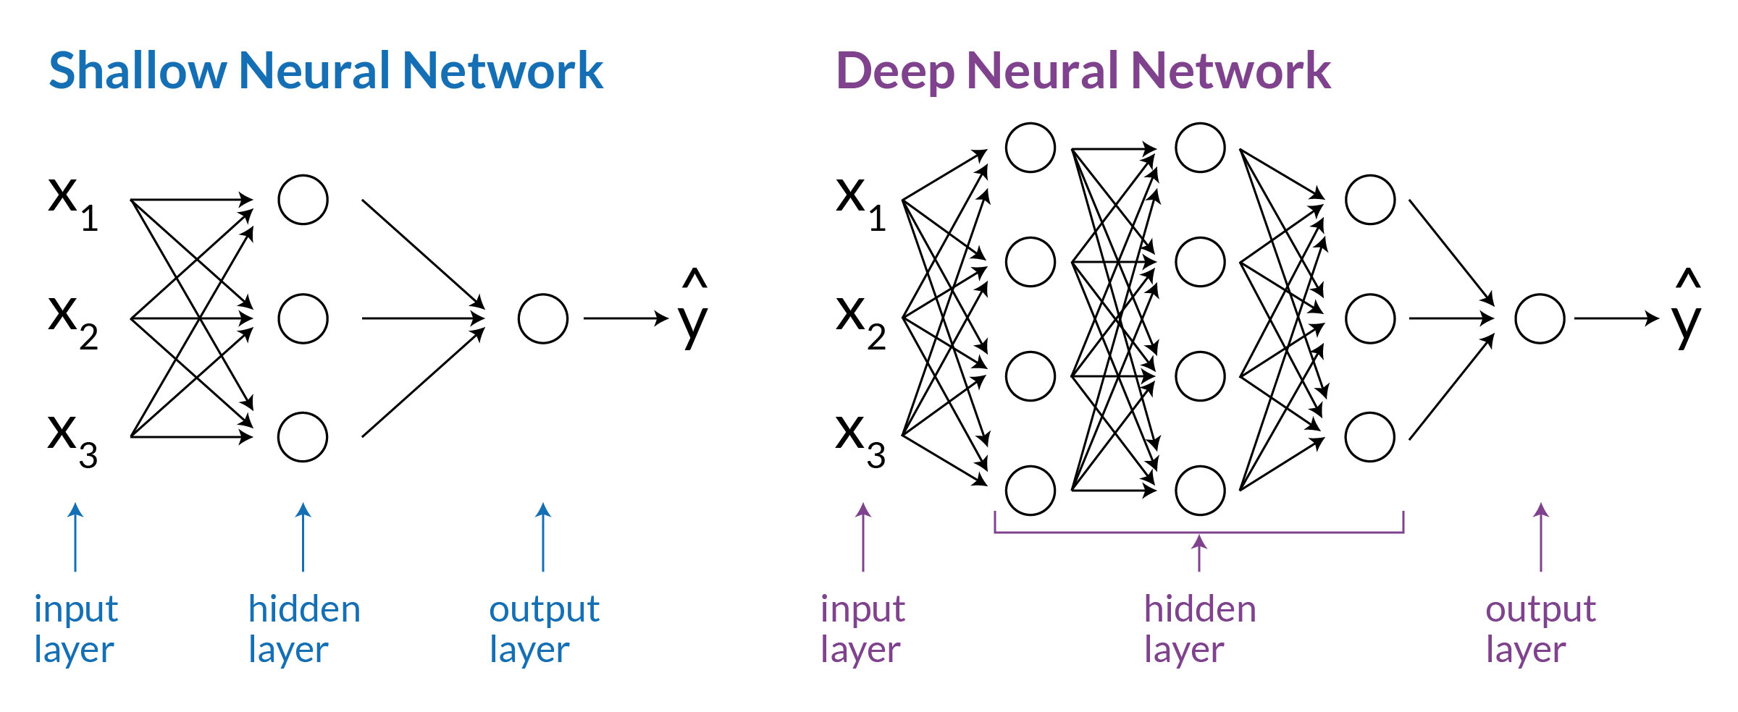
Neural Networks

Slide 23
Salaries for Python Developers
 | Entry-Level | Mid-Level | Experienced | US | UK
Python Developer | ₹430,000 | ₹900,000 | ₹1,500,000 | $120,000 | £60,000
Web Developer | ₹350,000 | ₹720,000 | ₹1,600,000 | $78,000 | £45,000
Machine Learning | ₹500,000 | ₹780,000 | ₹1,600,000 | $140,000 | £50,000

Slide 24
Thanks!
Any questions?

